Slide 1
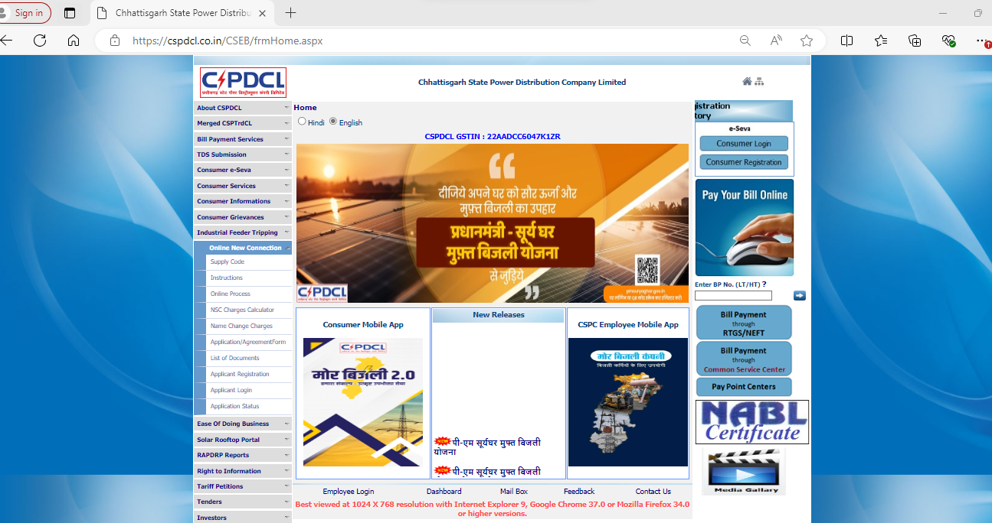
Visit http://www.cspdcl.co.in

Slide 2
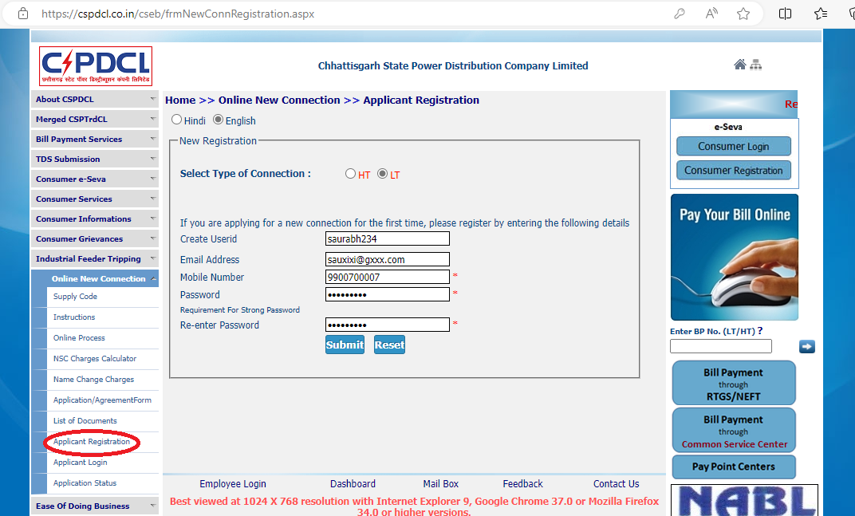
Applicant Registration

Slide 3
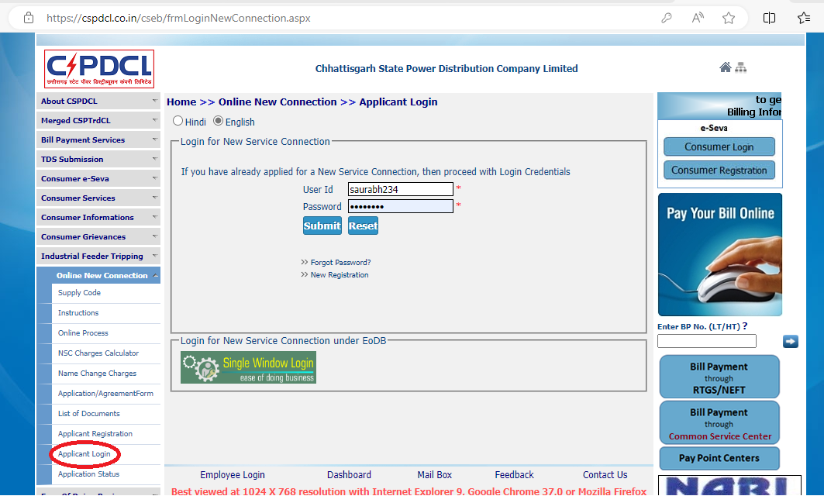
Applicant Login

Slide 4
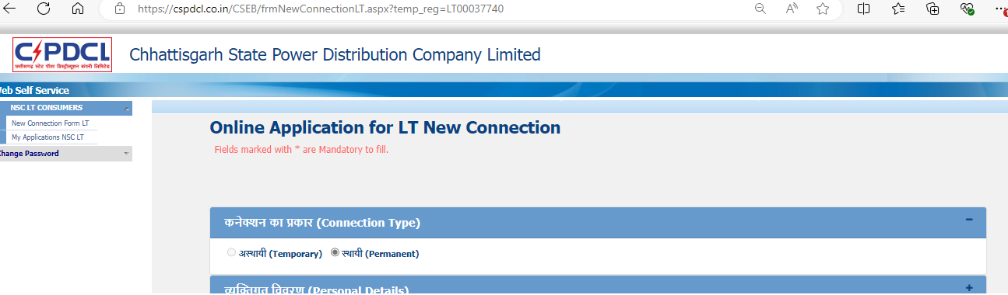
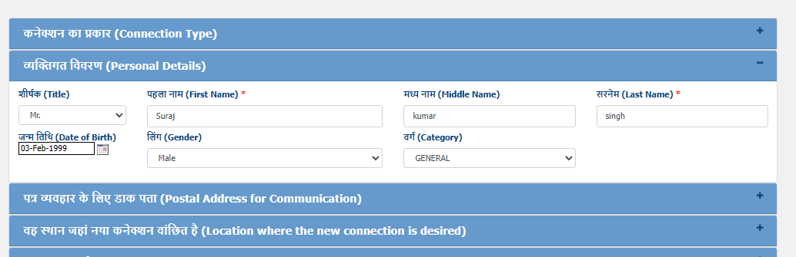
Application Form: Name and Personal details

Slide 5
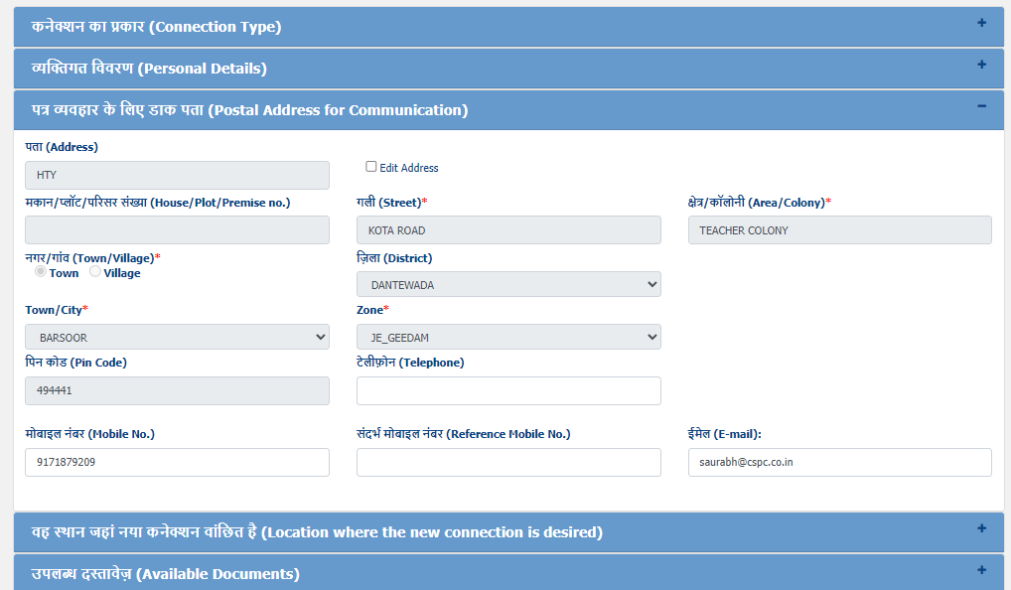
Application Form: Address related details

Slide 6
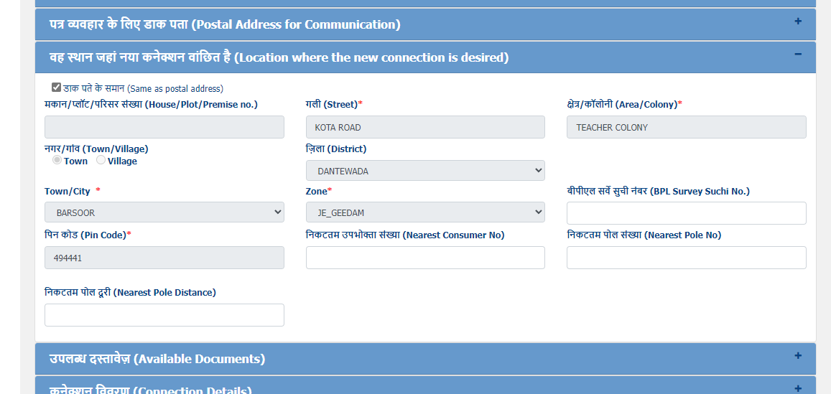
Application Form: Connection Address related details

Slide 7
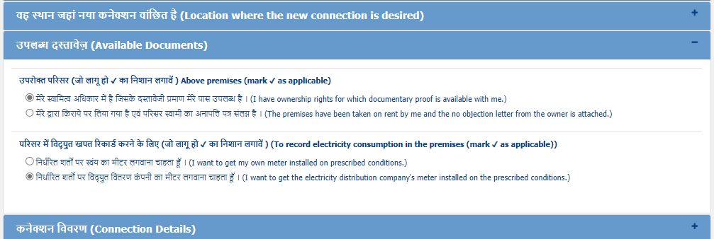
Application Form: Available Documents

Slide 8
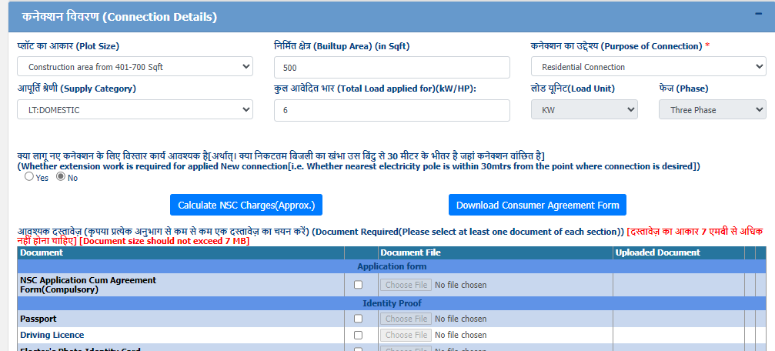
Application Form: Connection details
Consumer can get approximate charges for new connection that he has to pay by clicking “Calculate NSC Charges(Approx.)” button.
Consumer can download consumer agreement form by clicking on “Download Consumer Agreement Form” button.

Slide 9
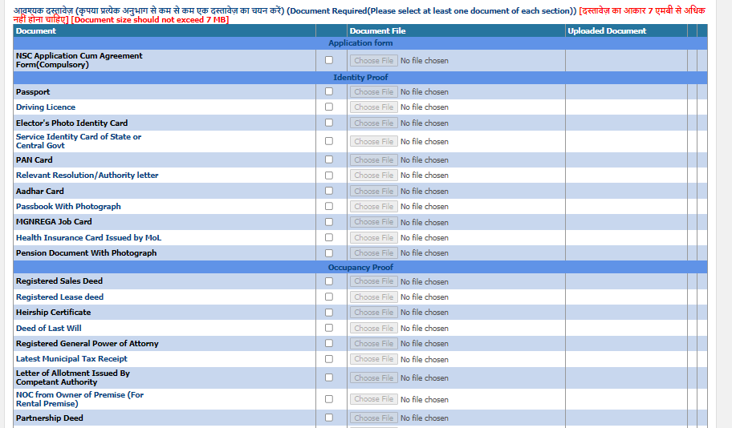
Application Form: Uploading of scanned supporting documents

Slide 10
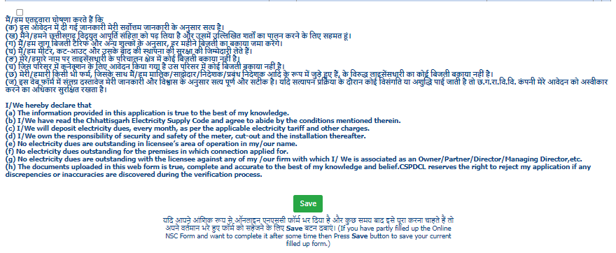
Application Form: Accept the terms and save the application
Consumer has to accept the terms and conditions by checking the ‘check-box’.
By clicking on ‘Save’ button, the application details will be saved and a temporary registration number will be provided.

Slide 11
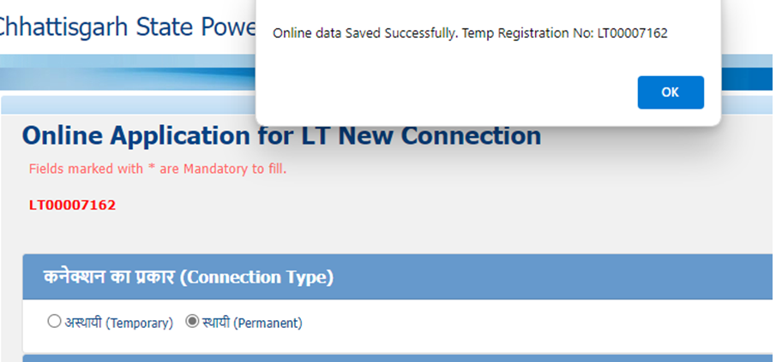
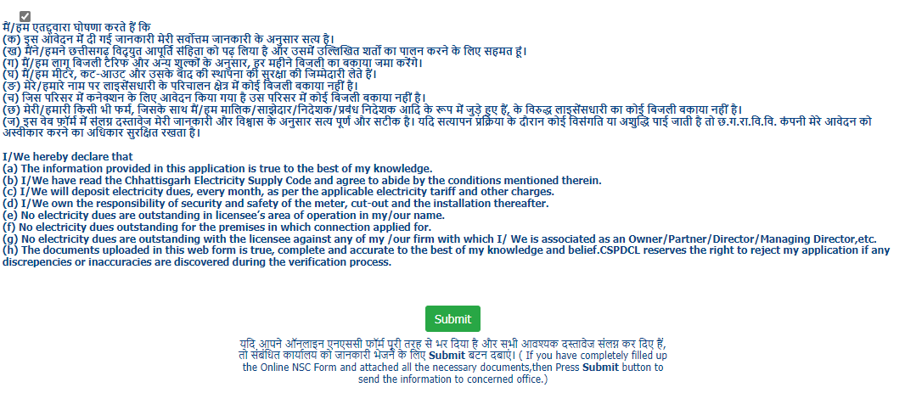
Application Form: Save Details and generation of LT Temporary Registration No.
Application Form: Submission
Click on submit button to submit the application.

Slide 12
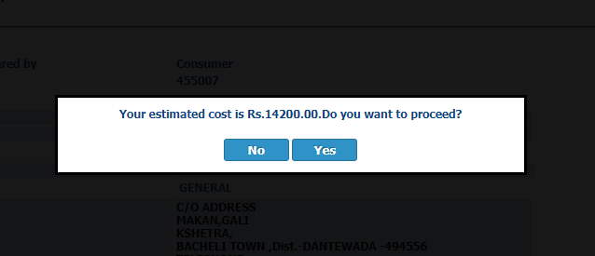
Estimated cost for New Connection is displayed.

Slide 13
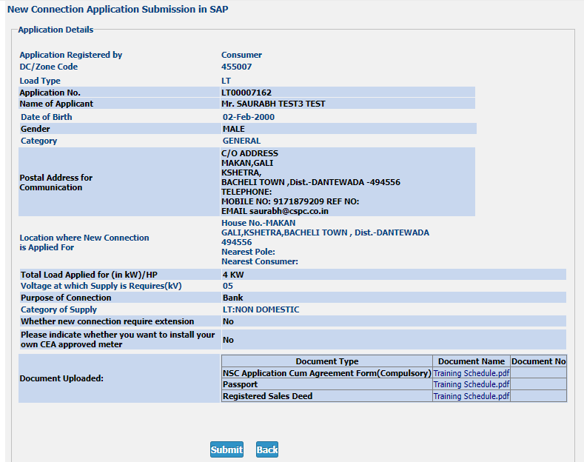
Verify information
Click on ‘submit’ button after verifying the information.

Slide 14
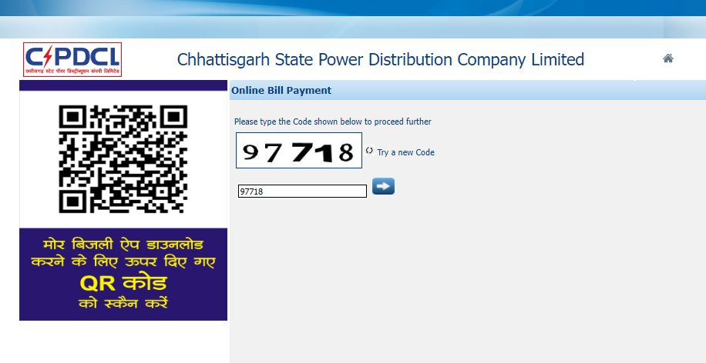
LT Consumer will be redirect to payment page.
Enter CAPCHA and proceed.

Slide 15
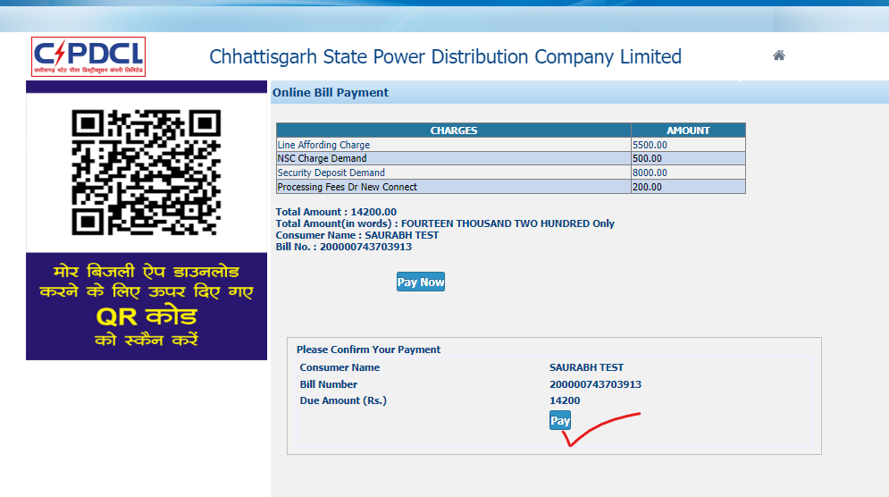
Click on pay button.

Slide 16
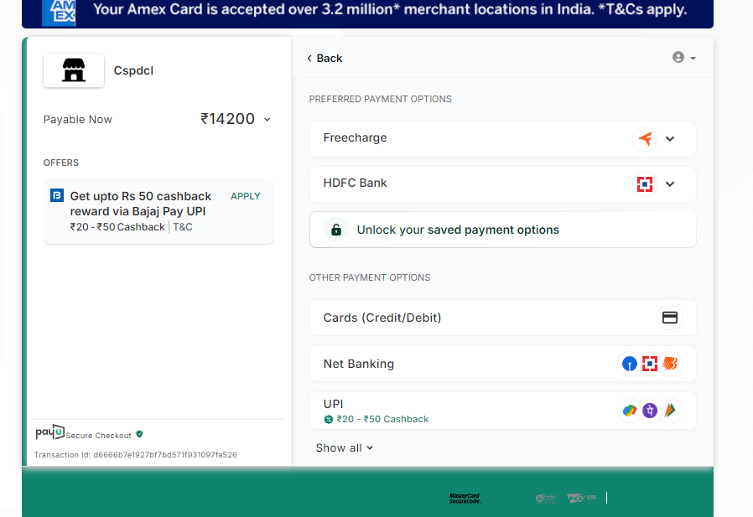
Complete the payment.

Slide 17
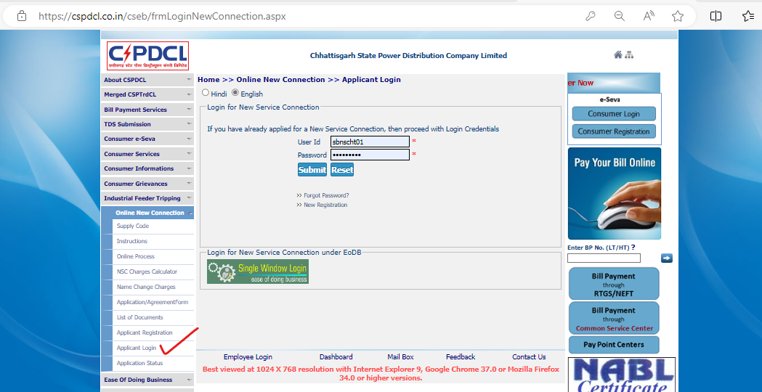
Consumer can login again using the menu “Applicant Login” under “Online New Connection”, to check application and payment status.
Login to check status.

Slide 18
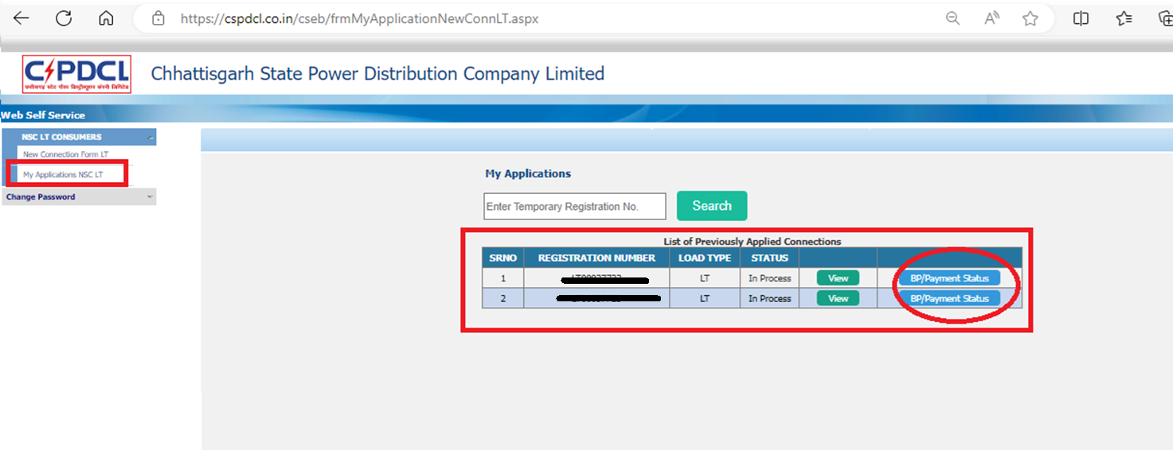
Consumer(NSC Applicant) can login using the menu “Applicant Login” under “Online New Connection”, to check application and payment status.
Checking payment status (1).

Slide 19
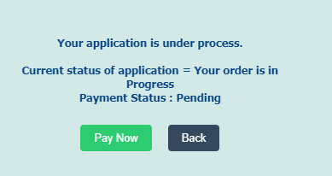
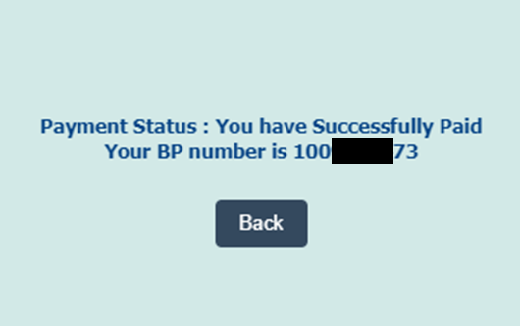
Payment status can be checked by clicking on “BP/payment status” button. After successful payment, Consumer will be able to see the BP Number.
Checking payment status (2).
OR

